Slide 1

Health Tracker

Slide 2
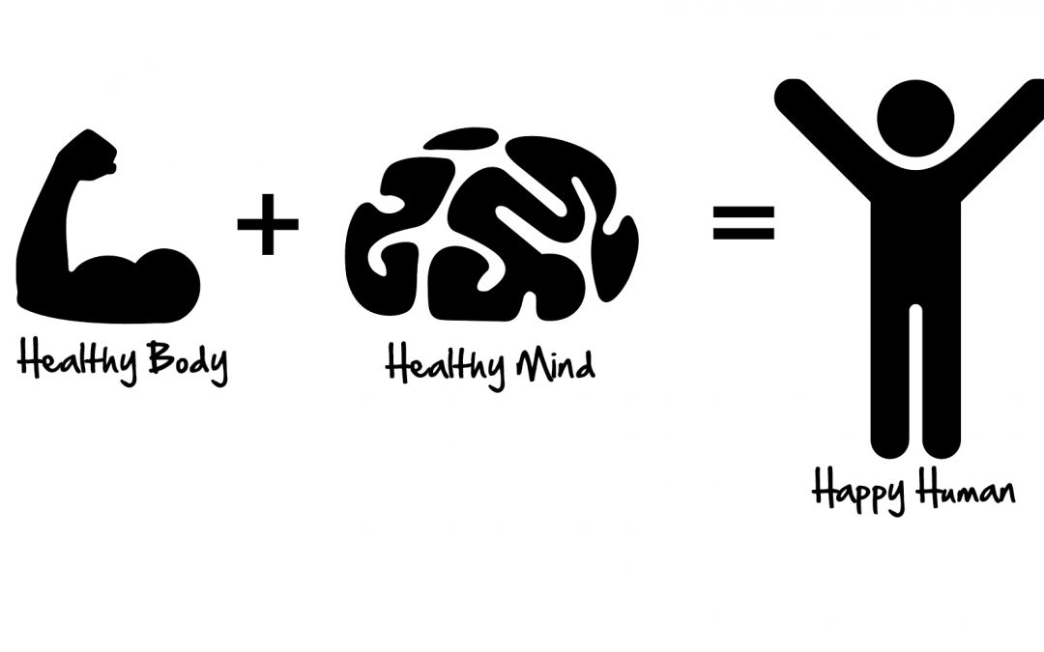
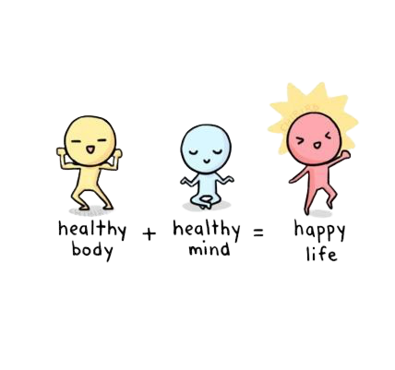

Slide 3
Group – 2: HEALTH TRACKER
ARNAB BANARJEE | RA2011047010002
ROSHAN UPADHYAY | RA2011047010015
SYED AREEB ADIL | RA2011047010025
PRATEEK UNIYAL | RA2011047010032
BHAVYA YADAV | RA2011047010149

Slide 4
ABSTRACT

Slide 5
The Abstract for our program includes the functions it performs as well as how it can be improved in the future in order to serve a larger purpose.

Slide 6
“To keep the body in good health is a duty otherwise we shall not be able to keep our mind strong and clear.”- Buddha.
Keeping this saying in mind which was given by Lord Buddha himself, our topic – ‘Health Tracker’ focuses on one of the most essential things in our life – health.
Health is the key to both happiness and success in our life.

Slide 7
Now, there are various methods and measures to ensure good health. One of the factors which inform us whether a person is healthy or not is his/her BODY MASS INDEX (BMI).
BMI is a person’s weight in kilograms divided by the square of his/her height in meters. It was basically designed to be used as a simple means of classifying average sedentary populations, with an average body composition.

Slide 8
Depending upon the BMI of a person, he/she is classified as:
Severely underweight – If BMI is less than 16.5 kg/m².
Underweight – If BMI is less than 18.5 kg/m².
Normal Weight – If BMI is greater than or equal to 18.5 – 24.9 kg/m².
Overweight – If BMI is greater than or equal to 25 – 29.9 kg/m².
Obesity – If BMI is greater than or equal to 30 kg/m².

Slide 9
Also, there are several diseases associated with the different BMI ranges. These diseases may necessarily not be present but there is a possibility for these diseases to be present.
Some of these diseases are:
Underweight – Malnutrition, osteoporosis, etc.
Overweight/Obesity – Back pain, diabetes, gout, asthma, etc.
In order to remain healthy, we need to have a balance of everything. One must have a proper diet as well as a proper fitness regime.

Slide 10
A proper diet basically refers to a balanced diet which is a diet containing all nutrients in adequate amounts, A balanced diet include a variety of items:
Fruits
Vegetables
Grains
Protein foods, etc.

Slide 11
Also, the User can get to know how much Calories he/she needs to eat in order to either Gain/Lose weight. A Mathematical Formula is used in the algorithm which takes into account the daily physical activities of the user before calculating the desired Calories.
Also, users would be able to see how much quantity (in grams) of the main 3 Macronutrients - carbohydrate, Fat, and Protein they must incorporate in their diet in order to reach their Calorie target calculated earlier.

Slide 12
For e.g. A 40-year-old Woman, who weighs 70 kg and is 160 cm tall and does Light Activity daily needs to eat 169.7 gm Carbohydrates,113.1 gm Proteins and 41.9 gm Fats daily in order to lose weight.
Also, the program takes into account the user’s family disease history, age and BMI in order to suggest if they have risk of developing Diabetes or Stroke in the future.
Thus, our topic is very useful and, more importantly it provides a convenient and easy way to keep our health in check.

Slide 13
Our Program can be improved further by incorporating sensors along with Machine Learning Algorithms in order to accurately get data from the user and give out an accurate result and prediction for the user.
This kind of a program can be widely used in the Health Care Sector in order to reduce manual load for data input and analysis in Hospitals. This can also play a role in combating the problem of shortage of Doctors (required for Basic Check-up in this case) in India.

Slide 14
FLOWCHART

Slide 15
Start
Input Name
Input Age
Input Gender

Slide 16
Input Weight
Input Height
BMI = Weight/Height^2

Slide 17
BMI < 16.5
False
True
Print “Severely Underweight”
16.5 < BMI && BMI< 18.5
16.5 < BMI < 18.5
False
True
Print “Underweight”
18.5 < BMI && BMI< 24.9
False
True

Slide 18
Print “Normal Weight”
25<=BMI && BMI<=29.9
False
True
30<=BMI && BMI<= 34.9
Print “Overweight”
False
True
35<=BMI && BMI< 39.9
Print “Obesity Class I”
False
True

Slide 19
BMI>= 40
False
Print “Overweight”
True
Print “Obesity Class I”

Slide 20
Gender = Male
Gender = Female
BMR = 10 x Weight + 6.25 x Height – 5 x Age + 5
BMR = 10 x Weight + 6.25 x Height – 5 x Age – 161
INPUT LevelOfActivity

Slide 21
LevelOfActivity=Sedentary or light activity lifestyle
True
False
TDEE=1.5xBMR
LevelOfActivity = Active or moderately active lifestyle
True
False
TDEE=1.8xBMR
LevelOfActivity= Vigorous or vigorously active lifestyle
True
False

Slide 22
TDEE=2.2xBMR
INPUT GOAL
GOAL=WeightLoss
True
False

Slide 23
GOAL=WeightGain
RC=TDEE-500
GOAL=WeightGain
True
Carbohydrate = (0.45xRC)/4 gm Protein = (0.30xRC)/4 gm Fat = (0.25xRC)/9 gm
RC=TDEE+500
False
Carbohydrate = (0.30xRC)/4 gm Protein = (0.40xRC)/4 gm Fat = (0.30xRC)/9 gm
INPUT FamilyHistoryDiabetes

Slide 24
FamilyHistoryDiabetes=TRUE
True
AGE>=45
True
BMI>=30
False
False
True
False
PRINT "You are at Risk of Diabetes and Stroke"
DISPLAY AdditionalHealthDetails
DISPLAY AdditionalHealthDetails

Slide 25
INPUT CoronaSymp
CoronaSymp=TRUE
True
False
PRINT "Get yourself Tested ASAP!
PRINT "Keep wearing a Mask and maintain Social Distancing!"
END

Slide 26
ALGORITHM

Slide 27
STEP 1: START
STEP 2: INPUT Name, Age, Gender, Weight, Height
STEP 3: BMI=Weight/Height^2
STEP 4: IF BMI<16.5 PRINT "Severely Underweight"
STEP 5: ELSE IF 16.5<BMI && BMI<18.5 PRINT "Underweight"
STEP 6: ELSE IF 18.5<=BMI && BMI<=24.9 PRINT "Normal Weight"

Slide 28
STEP 7: ELSE IF 25<=BMI && BMI<=29.9 PRINT "Overweight"
STEP 8: ELSE IF BMI>=30 && BMI<=34.9 PRINT "Obesity Class I"
STEP 9: ELSE IF 35<=BMI && BMI<=39.9 PRINT "Obesity Class II"
STEP 10: ELSE IF BMI>= 40 PRINT "Obesity Class III"

Slide 29
STEP 11: IF Gender=Male, BMR = 10 x Weight + 6.25 x Height – 5 x Age + 5
STEP 12: ELSE IF Gender=Female, BMR = 10 x Weight + 6.25 x Height – 5 x Age – 161
STEP 13: INPUT LevelOfActivity
STEP 14: IF LevelOfActivity=Sedentary or light activity lifestyle, TDEE=1.5xBMR

Slide 30
STEP 15: ELSE IF LevelOfActivity = Active or moderately active lifestyle, TDEE=1.8xBMR
STEP 16: ELSE IF LevelOfActivity= Vigorous or vigorously active lifestyle, TDEE=2.2xBMR
STEP 17: INPUT GOAL
STEP 18: IF GOAL=WeightLoss, RC=TDEE-500 Carbohydrate = (0.45xRC)/4 gm, Protein = (0.30xRC)/4 gm, Fat = (0.25xRC)/9 gm

Slide 31
STEP 19: ELSE IF GOAL=WeightGain, RC=TDEE+500, Carbohydrate = (0.30xRC)/4 gm, Protein = (0.40xRC)/4 gm, Fat = (0.30xRC)/9 gm
STEP 20: INPUT FamilyHistoryDiabetes
STEP 21: IF FamilyHistoryDiabetes=TRUE, IF AGE>=45 ,IF BMI>=30 PRINT "You are at Risk of Diabetes and Stroke"
STEP 22: DISPLAY AdditionalHealthDetails

Slide 32
STEP 23: INPUT CoronaSymp, IF CoronaSymp=TRUE, PRINT "Get yourself Tested ASAP!”
STEP 24: ELSE PRINT "Keep wearing a Mask and maintain Social Distancing!"
STEP 25: END

Slide 33
PSEUDOCODE

Slide 34
GET variables Name, Age, Gender, Weight, Height
COMPUTE the BMI
BMI=Weight/Height^2
IF BMI is smaller than 16.5
PRINT “Severely Underweight”
ELSE IF BMI is greater than 16.5 and greater than 18.5
PRINT "Underweight"
ELSE IF BMI is greater than or equal to 18.5 and smaller than or equal to 24.9
PRINT "Normal Weight"

Slide 35
ELSE IF BMI is greater than or equal to 25 and smaller than or equal to 29.9
PRINT "Overweight"
ELSE IF BMI is greater than or equal to 30 and smaller than or equal to 34.9
PRINT "Obesity Class I"
ELSE IF BMI is greater than or equal to 35 and smaller than or equal to 39.9
PRINT " Obesity Class II"

Slide 36
ELSE IF BMI is greater than or equal to 40
PRINT " Obesity Class III"
IF Gender is Male
Compute BMR = 10 x weight + 6.25 x Height -5 x Age + 5
ELSE IF Gender is Female
COMPUTE BMR = 10 x Weight + 6.25 x Height – 5 x Age – 161
GET LevelOfActivity

Slide 37
IF LevelOfActivity of a person is Sedentary or light activity lifestyle
COMPUTE TDEE=1.5xBMR
ELSE IF LevelOfActivity of a person is Active or moderately active lifestyle
COMPUTE TDEE=1.8xBMR
ELSE IF LevelOfActivity of a person is Vigorous or vigorously active lifestyle
COMPUTE TDEE=2.2xBMR

Slide 38
GET Goal
IF Goal of the person is WeightLoss
Compute the Required Calories(RC), Carbohydrate, Protein and Fat
RC=TDEE-500
Carbohydrate = (0.45xRC)/4 gm
Protein = (0.30xRC)/4 gm
Fat = (0.25xRC)/9 gm

Slide 39
ELSE IF Goal of the person is WeightGain
RC=TDEE+500
Carbohydrate = (0.30xRC)/4 gm,
Protein = (0.40xRC)/4 gm
Fat = (0.30xRC)/9 gm
GET FamilyHistoryDiabetes

Slide 40
IF FamilyHistoryDiabetes is TRUE (which means a person in his family has diabetes)
IF AGE is greater or equal to 45
IF BMI is greater or equal to 30
PRINT "You are at Risk of Diabetes and Stroke"
DISPLAY AdditionalHealthDetails
GET CoronaSymp

Slide 41
IF CoronaSymp is TRUE
PRINT "Get yourself Tested ASAP!”
ELSE
PRINT "Keep wearing a Mask and maintain Social Distancing!"
END

Slide 42
Thank You

